Slide 1
Practice Session 6
Economics of Happines

Slide 2
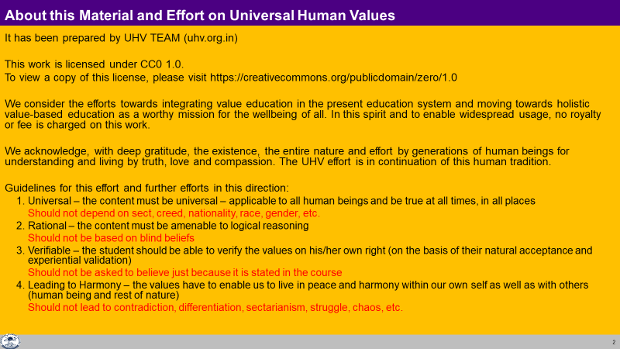

Slide 3
Economics of Happiness
Watch a 20 minute video summary of Economics of Happiness
Source (full documentary): https://www.localfutures.org/programs/the-economics-of-happiness/the-film/
It is a documentary about the impact of globalisation on Ladakh
We will discuss your observations:
What is the prevailing view about the goal of society, as shown in the video?
What are some of the achievements, and side-effects of the prevalent world-view?
Is there any solution to the present-day problems?

Slide 4
Globalisation
We talk about Global Village – the world has been connected physically by technology
What about the mindset – to live together globally? Do we have such a global world-view? Or is our way of thinking completely individualistic?
If our world-view is not global, if our mindset is not one of living in a relationship of mutual fulfillment globally, if our thinking is not for global order and we get connected physically, then what will be the impact?
The impact will be exploitation of people as well as exploitation of nature – globally
And we can observe this today

Slide 5
Global World View
So there is a need for a global world view
What can such a world view be?
Essential requirements of a global world view:
  Recognition of human aspiration
  Provides all encompassing solution for fulfillment of human aspiration
What do you think? Is it essential to ensure both these?
We need to decide what to Localise & what to globalise

Slide 6
Localise Globalise
Food
Clothes
House
Etc.
Needs of the Body
Mindset – of living in a relationship of mutual fulfillment globally
Needs of the Self (I)

